Slide 1

Presented by : Kashish Solkhiya

Slide 2





Table of Contents
Intro of AtliQ Grand
Problem statement & Objective
Dashboard & Explanation
Insights & Recommendations

Slide 3
Intro of AtliQ Grand
AtliQ Grands operates a network of five-star hotels across India.
AtliQ Grands has been an established presence in the hospitality industry for over 20 years.
AtliQ Grands operates a distinguished collection of five-star hotels in key cities such as Delhi, Mumbai, Hyderabad, and Bangalore.
Hotels with their Categories are – Luxury and Business
Types of Room Category – Standard, Elite, Premium, Presidential

Slide 4
Problem statement & Objective
AtliQ Grands is confronted with a significant business challenge: declining market share and revenue in the luxury/business hotels segment due to ineffective decision-making. Compounding the issue is the absence of an in-house data analytics team, leaving them without crucial insights. To address this, the managing director aims to integrate business and data intelligence into their strategies. However, reliance on third-party services for historical data insights highlights the pressing need for a comprehensive solution to enhance revenue management and regain competitive advantage.
Problem Statement :-
As a data analyst, my primary business objective is to evaluate the overall performance of AtliQ Grands' hotels, integrating key metrics such as revenue growth trends, room optimization, and booking analysis. By harnessing data intelligence, I aim to provide a holistic understanding of the hotels' performance, including their overall rating. This analysis will enable me to offer insightful recommendations aimed at enhancing efficiency, maximizing revenue, and improving customer satisfaction for sustained business growth.
Objective :-

Slide 5
Key Metrics
ADR(Average Daily Rating) – is a key metrics in the hospitality industry, representing the average amount of revenue earned per room in a hotel.
DBRN(Daily Booking Room Nights) – Refers to number of rooms booked by guests in a hotel for a single day.
DSRN(Daily Sellable Room Nights) – Refer to the total number of hotel rooms that are available for guests to book any given day.
RevPAR(Revenue Per Available Room) – It’s a key performance metric in hotel industry, calculated by dividing total room revenue by the number of available rooms
Realisation% - Refer to make the expected money from bookings and other services actually happen, like when guests pay for their rooms and additional services they use during stay.
Occupation % - Indicate the percentage of hotel rooms that are occupied during a specific time frame, reflecting a hotel’s ability to fill available rooms and generate revenue.

Slide 6
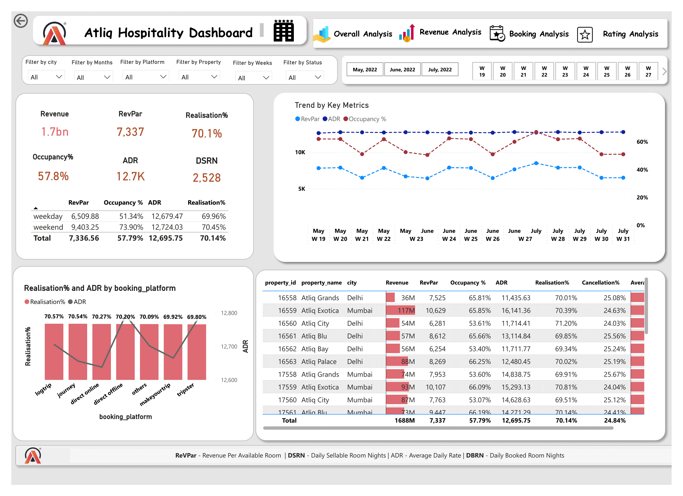

Slide 7
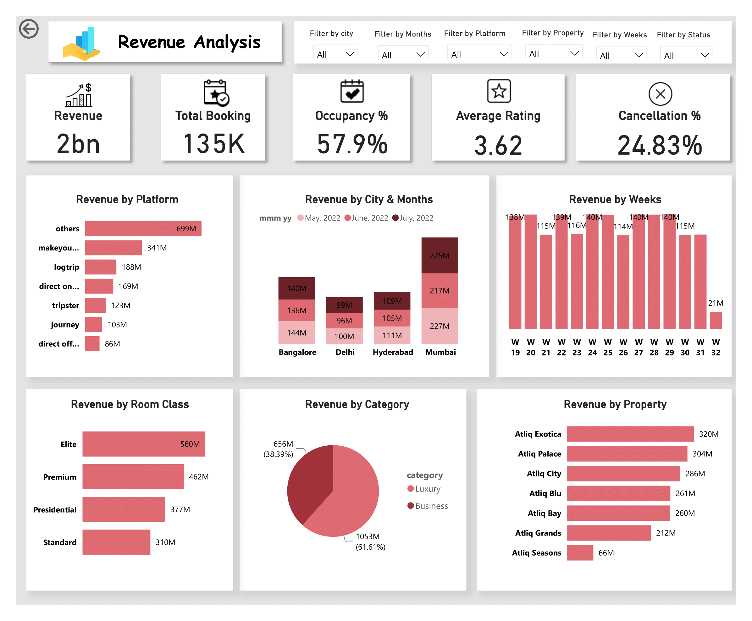

Slide 8
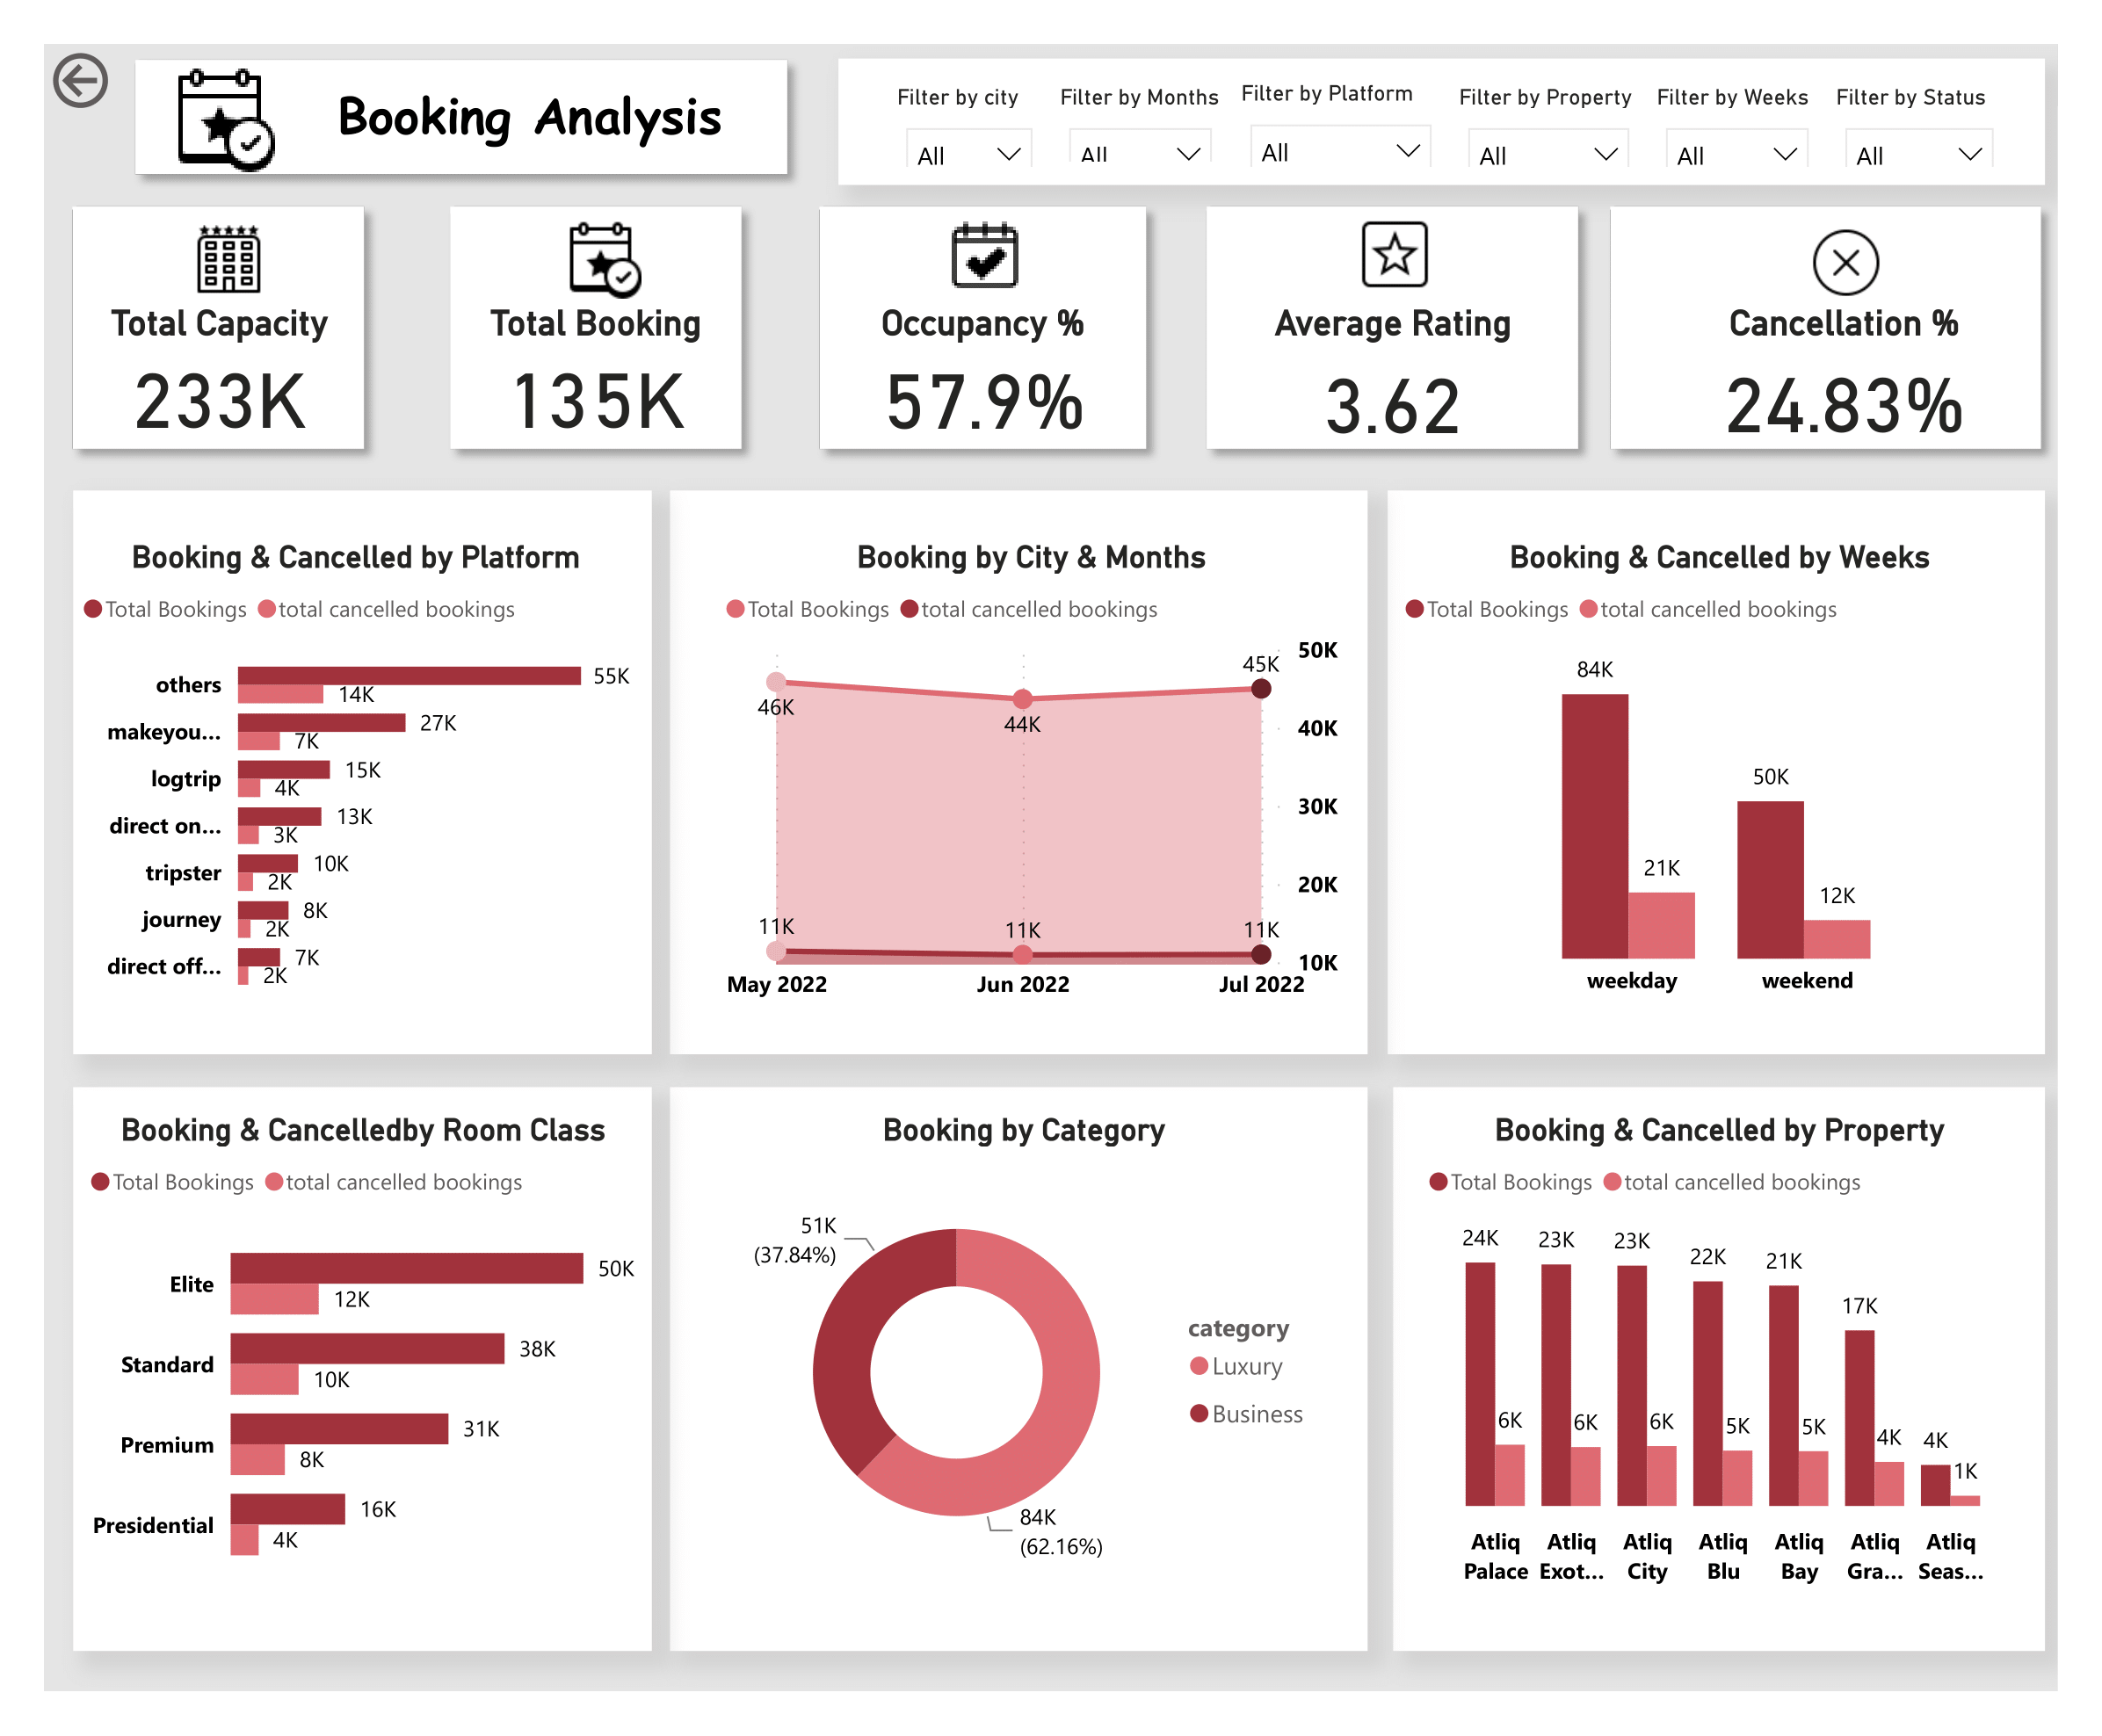

Slide 9
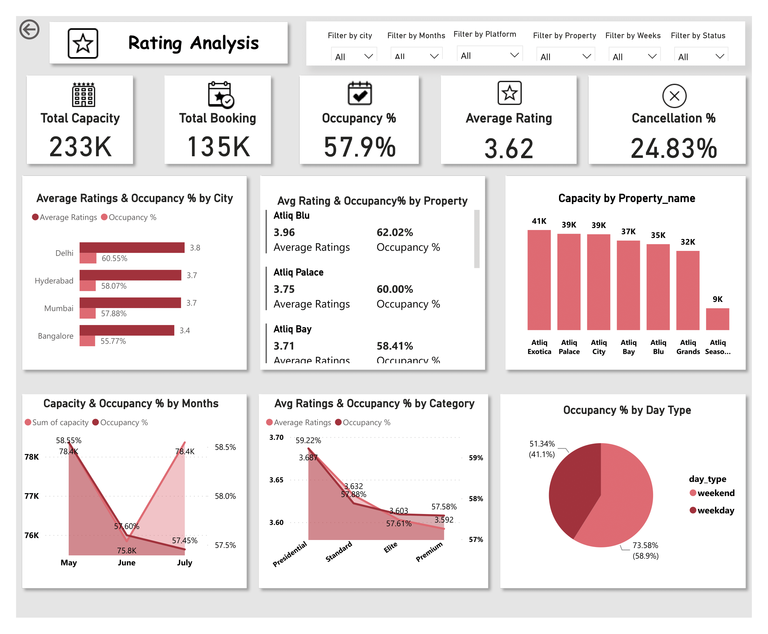

Slide 10
AtliQ Grand Hospitality generated 1.7 billion in revenue with a RevPAR of 7,000 and an ADR of 12,700.
The Realization percentage was 70.1%, with an occupancy rate of 57.8% and 2528(DSNR) daily sellable room nights.
Logtrip had the highest realization at 70.57%, and direct offline bookings had the highest ADR at 12,793.
Tripster had the lowest realization at 69.80%, while Journey and Makeyourtrip had the lowest ADRs around 12,655.
Overall, ADRs were consistent across platforms, with slight variances in realization percentages.
During the Analyzed period, ADR remained stable between 1264 and 1275. Occupancy rates varied significantly, from 50.49% in week 23 of June to 66.97% in week 27 of July.
Consequently, RevPAR peaked in weeks with higher occupancy, especially week 27 of July.
The Others platform leads with 699m, while Direct Offline generates 86m. Mumbai consistently outperforms Delhi in revenue, especially in May.
Luxury category leads with 1053m, with Business following at 656m.
AtliQ Exotica significantly outperforms AtliQ Seasons, with 320m compared to 66m in revenue.
Others platform dominates with 55k bookings, but faces 14k cancellations, signalling possible reservation issues.
Mumbai maintains high monthly bookings of 15k, indicating sustained demand. Weekends show a surge with 84k bookings, but 21k cancellations hint at instability.
Elite rooms are popular with 50k bookings, while Luxury category bookings hit 84k, emphasizing upscale demand.
AtliQ Palace leads with 24k bookings, while AtliQSeasons records the lowest at 3k, suggesting lower demand or challenges.
The overall average rating is 3.62, indicating moderate satisfaction. Cities like Delhi and Bangalore boast higher ratings and decent occupancy rates, while properties like AtliQ Blue excel with a 3.96 rating and 62.02% occupancy.
AtliQ Season lags behind with a low rating of 2.29 and occupancy at 44.62%. Varied total capacities among properties and consistent occupancy levels in May and June imply stable demand. Weekend occupancy averages lower at 51.34% compared to weekdays at 73.58%.
Insights

Slide 11
Recommendations
1. Enhance Low-Performing Properties - Upgrade amenities, improve customer service, and address issues at properties like AtliQ Season. Use guest surveys to identify and fix specific problems.
2. Reduce Cancellations and Optimize Bookings - Investigate and resolve high cancellation causes on the Others platform and weekends. Improve booking processes, clarify policies, and promote high-realization platforms like Logtrip.
3. Leverage High-Performing Segments - Boost marketing for top-performing properties like AtliQ Exotica and popular room categories such as Luxury and Elite. Offer special packages and consider expanding successful categories.
4. Adjust Pricing and Promotions for Stability- Implement targeted marketing and dynamic pricing to manage occupancy fluctuations. Offer weekday promotions and appealing weekend packages to maximize RevPAR and reduce cancellations.

